Slide 1
Application lifecycle management (ALM) – DevOps strategy from scratch
David Rivard

Slide 2
THANK YOU TO THE COMMUNITY SPONSORS!

Slide 3

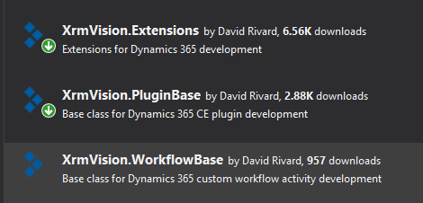
Speaker Profile
Power Platform Solution Architect / Senior Developer @ XRM Vision, Montréal
Main interests:
Plugin development
Integration through Azure (Azure functions, Service bus)
Devops (Build / Release pipelines)
…Some community contributions
Email : david.rivard@xrmvision.com
LinkedIn : https://www.linkedin.com/in/davidrivard/
Twitter : https://twitter.com/david_rivard

Slide 4
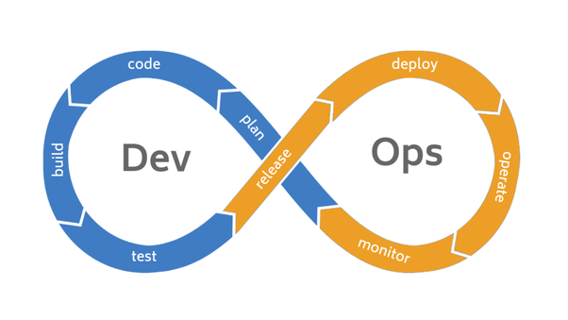
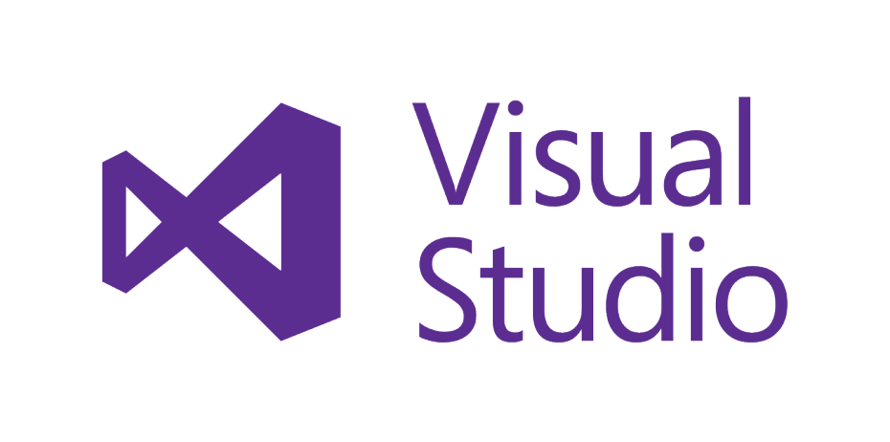
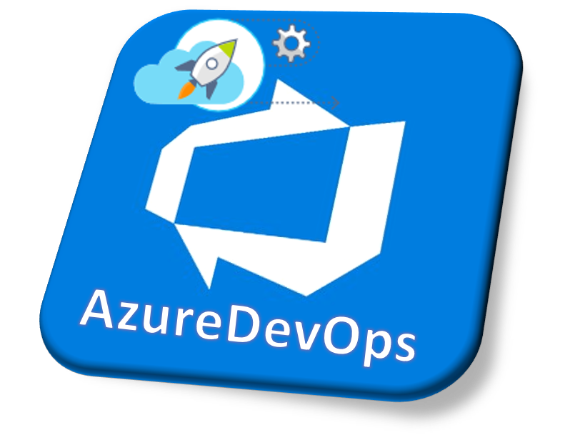
Agenda
Devops : Beyond the buzzword
Devops applied to Power Platform development
Real-Life Scenario – Start your Devops strategy from scratch
Resources :
Microsoft whitepaper
SDK Tools, Community Tools and Tutorials
DEMO : Full Build/Release pipeline:
Check-in solution metadata in source control
Build deployable solution from source control
Release to different environment (Unmanaged & Managed)
Notes:
Ask who is already using some kind of devops strategy in their projects?
I don’t have to convince you of the huge benefits it has on your project.
For the others, I hope I can spark up your interest in DevOPs, it’s a real game changer .

Slide 5
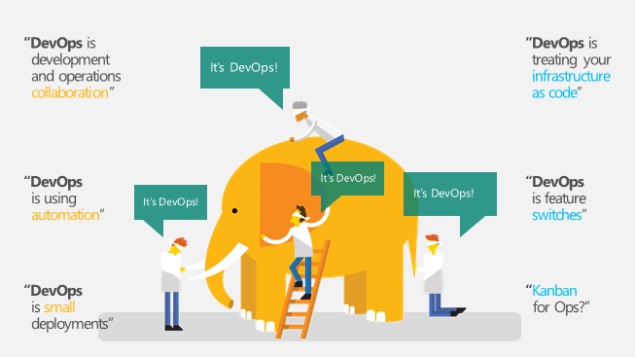
DevOps : Beyond the buzzword
Notes:
Devops is such a huge topic, that it’s not easy to get a clear description. Depending on your role in the organization, everyone will have a different definition.
_I don’t pretend to be a Devops expert and I just know it through my own galsses wich is delivering PowerPlatform solutions to my customer

Slide 6
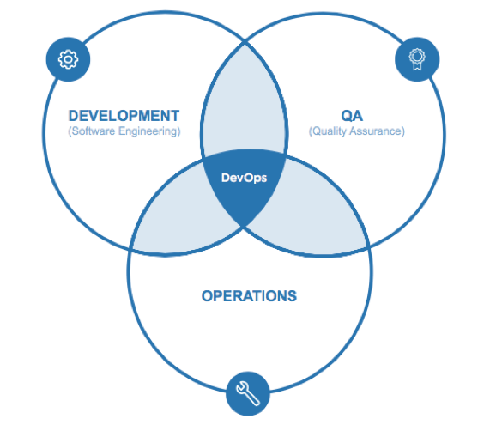
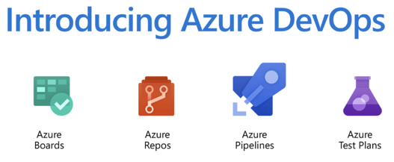
DevOps : Beyond the buzzword
DevOps is the union of people, process, and products to enable continuous delivery of value to our end users
A methodology that aims at breaking the silos between the different groups, bringing all the actors to work toward a common goal.
Using processes and tools to automate every steps of a software delivery, at the same time gathering and logging as much information as possible.
provide rapid feedback on the success/failure at every step so actions can be taken accordingly
Notes:
Note that products and tools comes in 3rd place.
The goal is always, to hit the bullseye wich is to deliver the software solution to Production
Its also a mean to have rapid feedback on the success/failure at every step so we can take actions accordingly

Slide 7
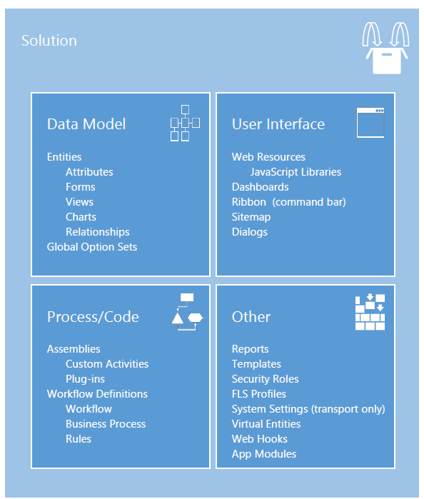
DevOps : Power Platform ALM Challenges
PowerPlatform solutions are mostly composed of 2 kind of elements
Configurations (Metadata) -- Mostly Point & Click in the GUI
Schema (Entities, views, forms)
Security Roles
Plugin registrations
Workflows
…
Customizations (Physical files)
Assemblies (Plugin, Custom workflow Activities)
Webresources (Javascript, Html, images)
Most of the time the configurations are not kept under source control
Deployments are often done manually
Challenging to have a multiple person working on a project
Merging the changes made in different environments into a single solution can be difficult.
Notes:
Don’t get me wrong, this is GOOD

Slide 8
DevOps : Applied to Power Platform
What a DevOps strategy can bring to your project
By having your whole solution customizations in source control, you always have the blueprint of your solution (and any prior versions) at hand
Confidence that deployments are repeatable and predictable
Protect your investment ($$)
Allows you to take more risks knowing that you can revert back to older versions at any time
Source comparison over time, traceability with work items
Analytics and insight on your application lifecycle
Notes:
Don’t get me wrong, this is GOOD

Slide 9
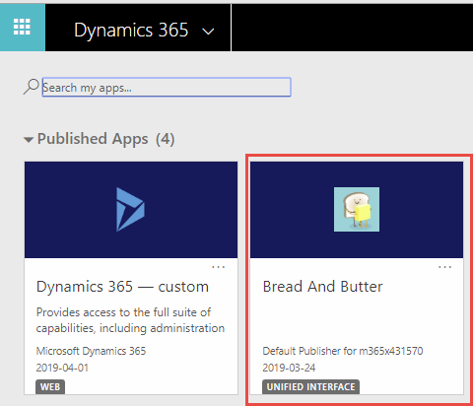
Real-Life Scenario : Starting From Scratch
App Name : Bread And Butter
Agile Project, has been going-on for more than a year
Recent architecture changes required to revert back 2 sprints
Dev team says it’s virtually impossible ;(
Plan is to go ISV with the solution and publish to AppSource
Goal : Be serious and Start the Devops Journey
Solution metadata should be checked-in in source control
Produce a Build/Release pipeline
Managed and Unmanaged solutions should be produced at every Build
Gated Release pipeline (ex. QA ->PROD)
Source Control
BUILD
Master
UNMANAGED
DEV 1
UNMANAGED
DEV 2
UNMANAGED
QA
MANAGED
PROD
MANAGED
Notes:
We have been working for more than a Year on this solution.
We have a lot of expectation for this app and we even think that It could be a good candidate for an ISV.
So we decided that we want to get serious and start the DevOps journey on this App.

Slide 10
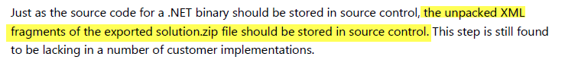
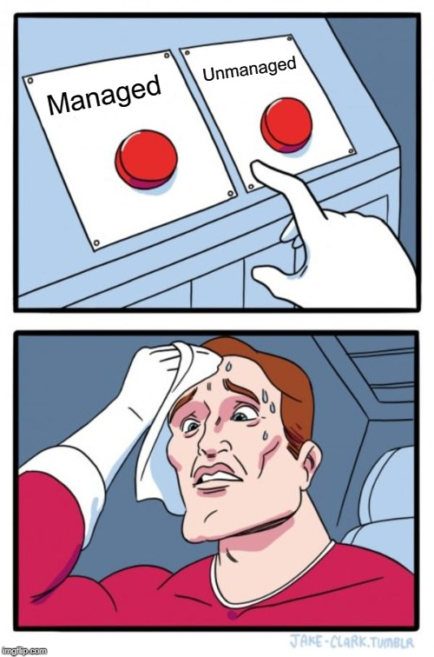
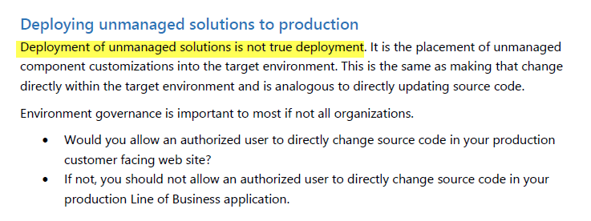
Resources : Microsoft Whitepaper on PowerPlatform ALM
Whitepaper: Solution Lifecycle Management For Dynamics 365 CE
https://www.microsoft.com/en-us/download/details.aspx?id=57777
Loads of information on Solution architecture and ALM best practices
ALM Maturity checklist
Some Quotes:
Notes:
Very good document that everyone working with PowerPLatform should read (and understand)
I will not allow my presentation to be highjacked by the Managed/Unmanaged debate… the solution I will show you later produces the 2 types of solution at every Build

Slide 11
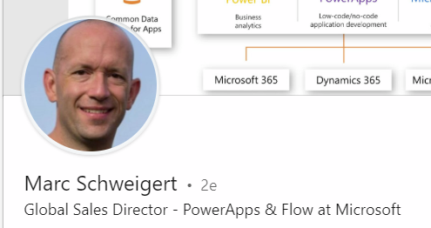
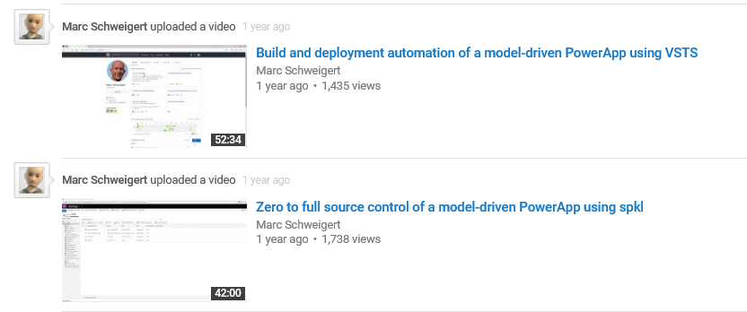
Resources : Tutorials on PowerPlatform ALM
IMHO.. The best tutorials on PowerPlatform ALM/Devops out there
https://github.com/devkeydet/dyn365-ce-devops
https://devkeydet.blog/
**BONUS : Starter templates for build/release definitions
Notes:
If you have one picture to take during my presentation it should be this slide
It’s the most comprehensive tutorial I have found and I highly recommend that you watch these 2 video, for me it was a real game changer.
You can even download AzureDevops Build/Release templates
In fact, the Build/release pipeline I will show you later is highly inspired by what I learned in these videos.

Slide 12
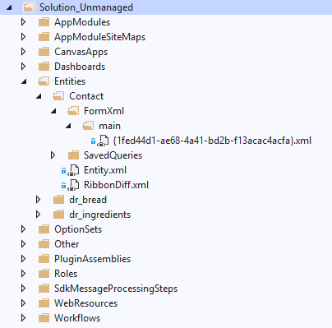
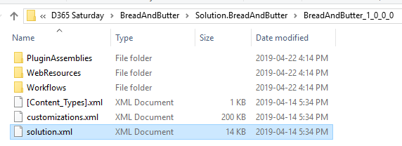
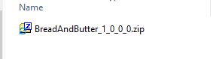
SDK Tools : Solution Packager
Extract
Pack
Solution Packager
Content of a .zip solution file
Packing will recompress the extracted files into a deployable solution file
Customizations are on one single file.
Almost impossible to track changes over time
Customizations.xml is exploded in several well classified and granular xml files.
When placed under source control, tracking the changes done to a single file over time is easily achievable

Slide 13
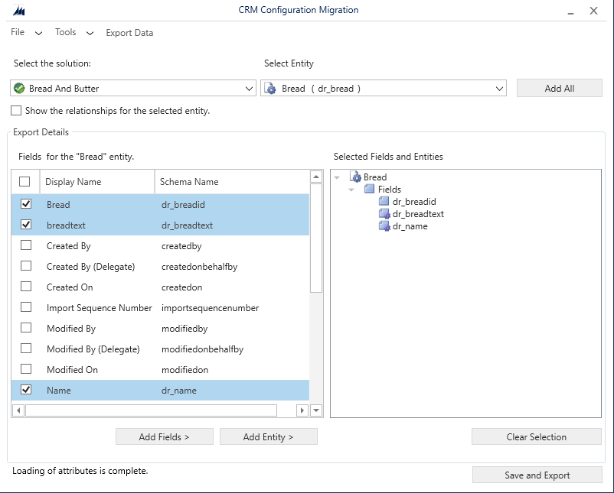
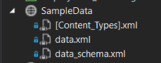
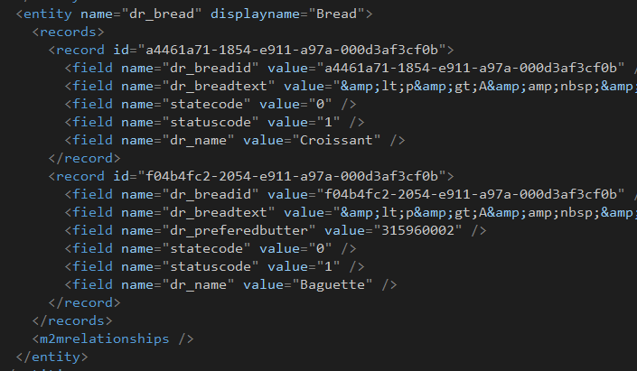
SDK Tools : Configuration Migration Tool
Creates a data extract .zip file
The zip file can be used by the Package Deployer later on to inject the data after a solution is deployed
Enforces Guid consistency across all organizations

Slide 14
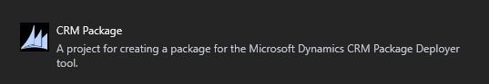
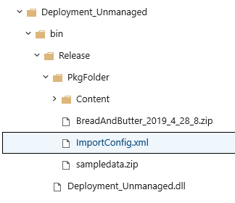
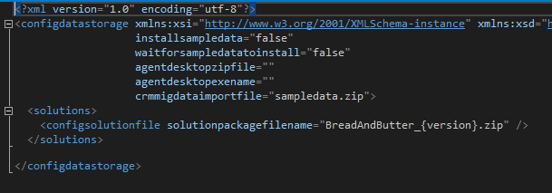
SDK Tools : Package Deployer
.Net assembly project
Contains a configuration file ImportConfig.xml
Solution to import
Data package to load after solution import
ISV : This format of package is required by Microsoft for AppSource publishing

Slide 15
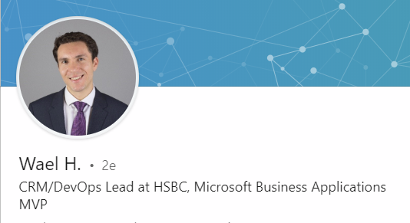
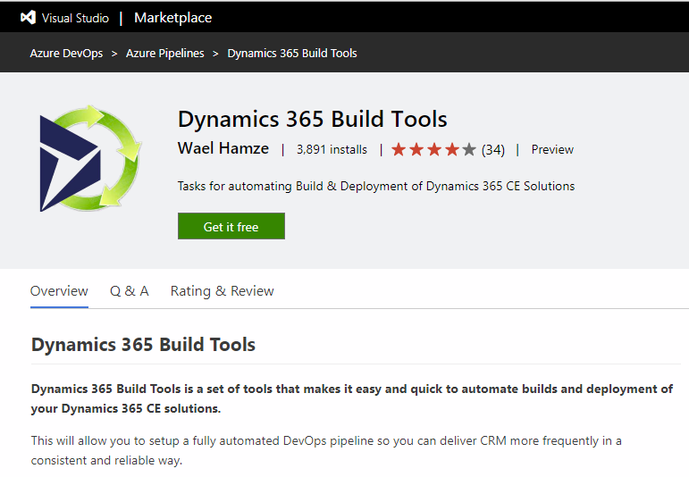
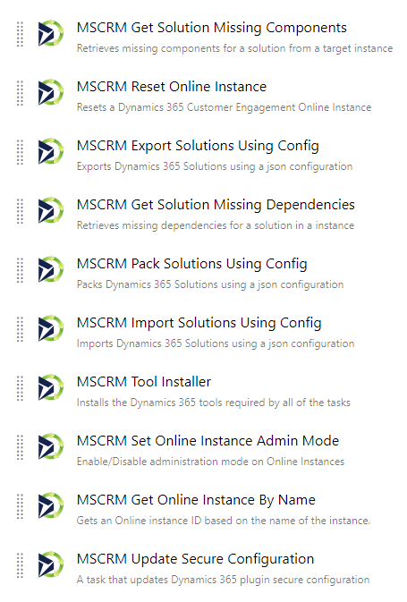
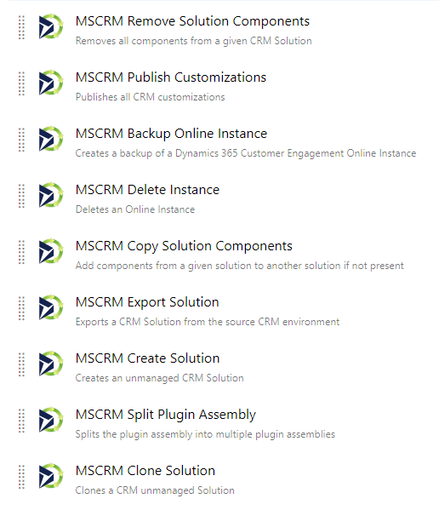
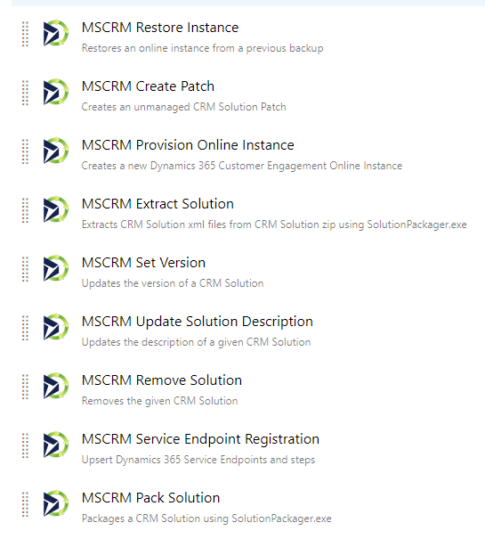
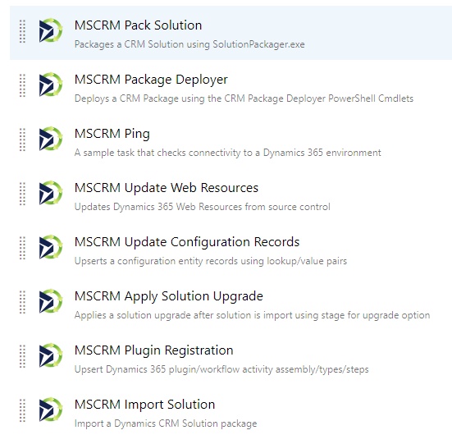
Tools : Dynamics 365 Build Tools
Extension for Azure Devops, Contains several configurable tasks that can be included in your Build/Release pipelines
THOSE TOOLS ARE LEGENDARY (AND FREE)!!
https://marketplace.visualstudio.com/items?itemName=WaelHamze.xrm-ci-framework-build-tasks
Notes:
- Instead of having to use ‘painful’ and error-prone PowerShell scripts, these tasks makes the definition of a Build/release pipeline

Slide 16
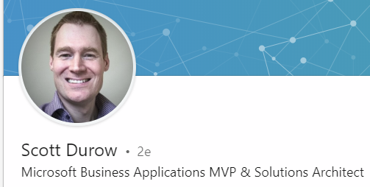
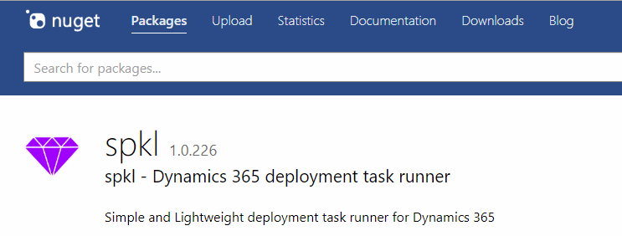
Tools : SPKL Task Runner
Nuget Package, Provide a way to interact with the SDK Tools (Solution Packager etc…) in a simple and configurable way
Will be used to UNPACK solutions from a MASTER environment
Notes:
I really want to point out the work of these individuals that put out these amazing tools free to use to the community.
They make our work so much easier

Slide 17
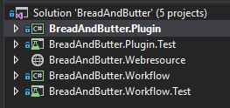
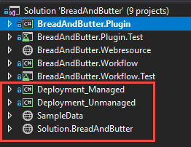
DEMO : Use Case – Starting From Scratch
STEP 1 : Source Control
UNPACK Solution
Sample Data
Deployment Project
DEMO
Code project before
Code project after
+ 2 deployment projects
+ 1 Sample data
+ 1 Solution project
(unpacked solutions)

Slide 18
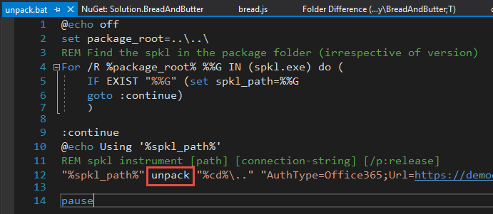
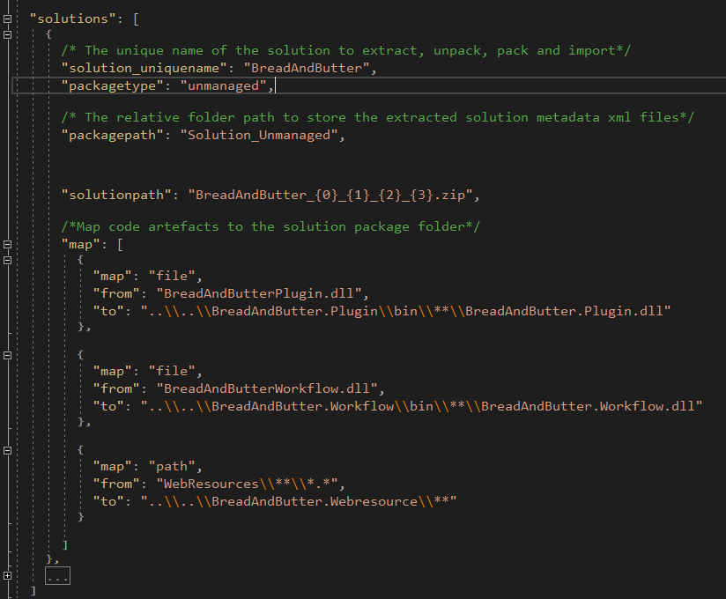
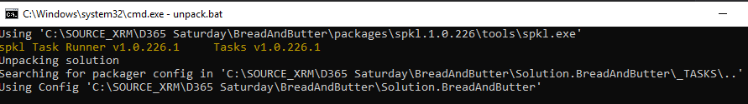
DEMO : Use Case – Starting From Scratch
STEP 1 : Source Control
Using SPKL Task runner to UNPACK

Slide 19
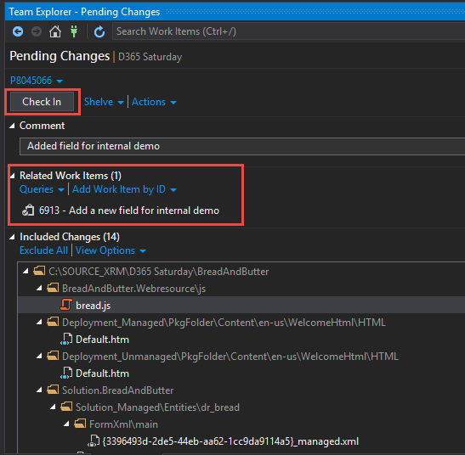
DEMO : Use Case – Starting From Scratch
STEP 1 : Source Control
CHECK-IN

Slide 20
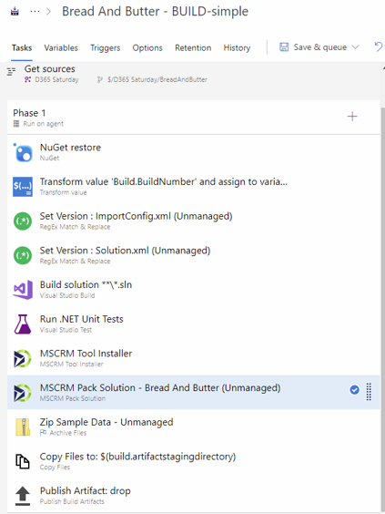

DEMO : Use Case – Starting From Scratch
STEP 2 : BUILD deployable packages from source control
DEMO
Get Sources
Compile Sources
Unit Tests
Pack Solution
Copy Solution To Deployment
Cloud based Agent

Slide 21
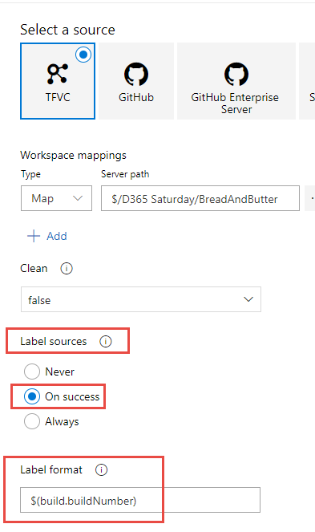
DEMO : Use Case – Starting From Scratch
STEP 2 : BUILD deployable packages from source control
DEMO

Slide 22
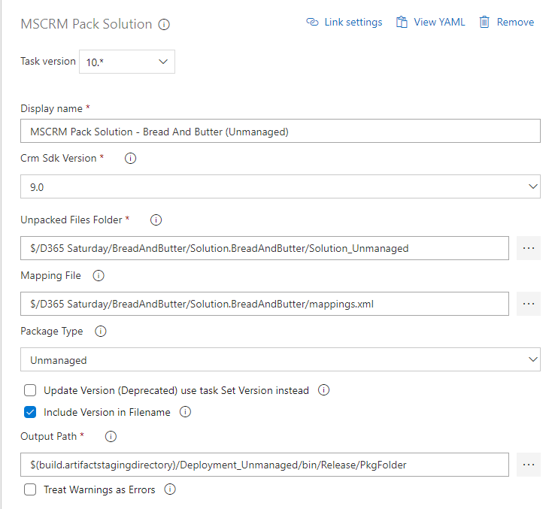
DEMO : Use Case – Starting From Scratch
STEP 2 : BUILD deployable packages from source control
DEMO

Slide 23
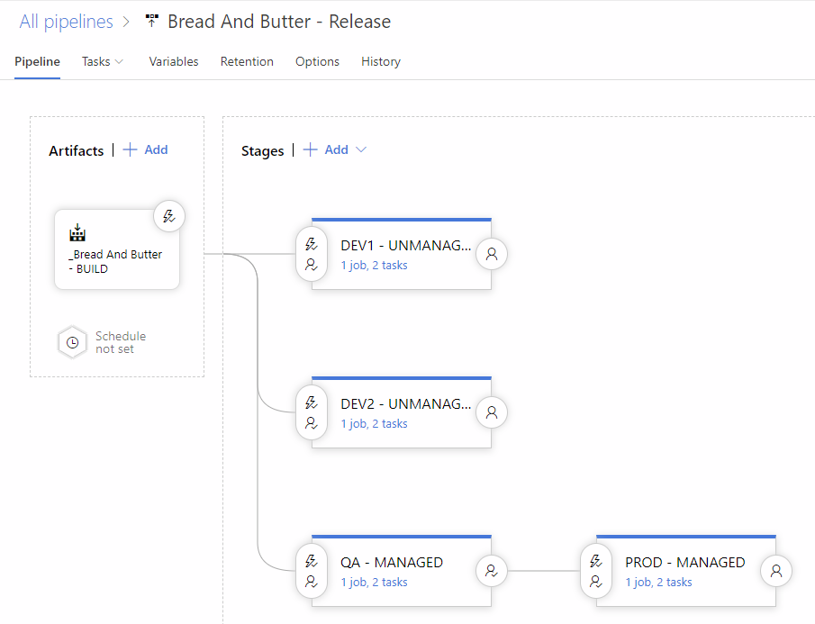
DEMO : Use Case – Starting From Scratch
STEP 3 : RELEASE to different environments
DEMO

Slide 24
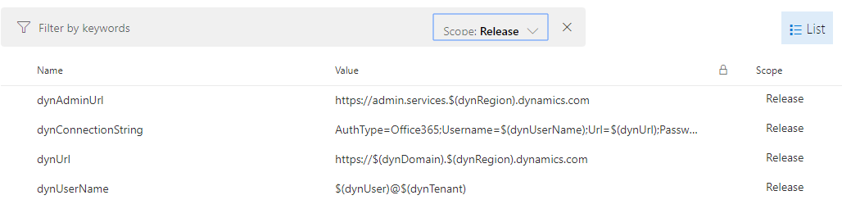
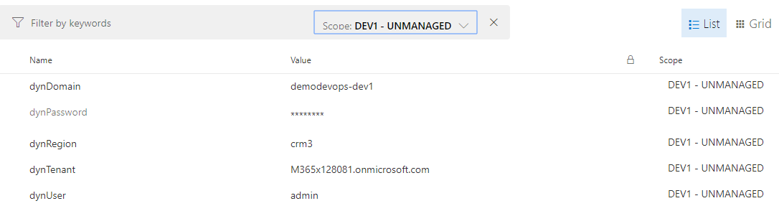
DEMO : Use Case – Starting From Scratch
STEP 3 : RELEASE to different environments
DEMO

Slide 25
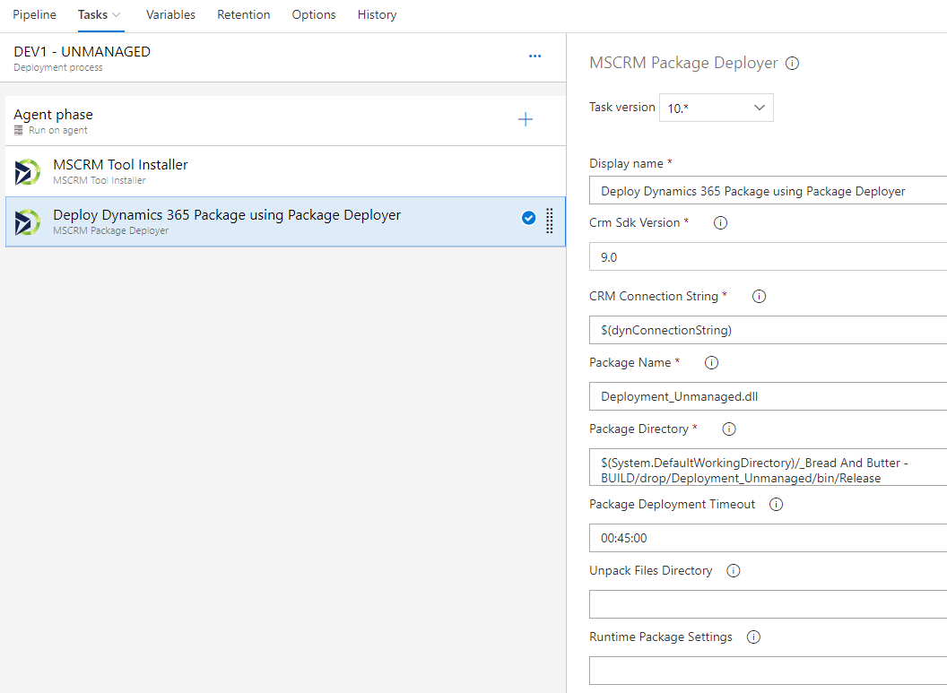
DEMO : Use Case – Starting From Scratch
STEP 3 : RELEASE to different environments
DEMO

Slide 26
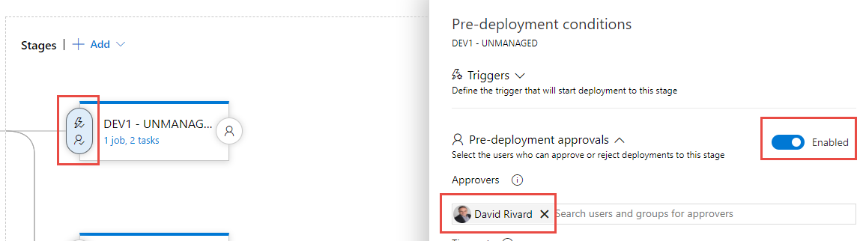
DEMO : Use Case – Starting From Scratch
STEP 3 : RELEASE to different environments
DEMO

Slide 27
DEMO : Use Case – Starting From Scratch
STEP 3 : RELEASE to different environments
DEMO

Slide 28
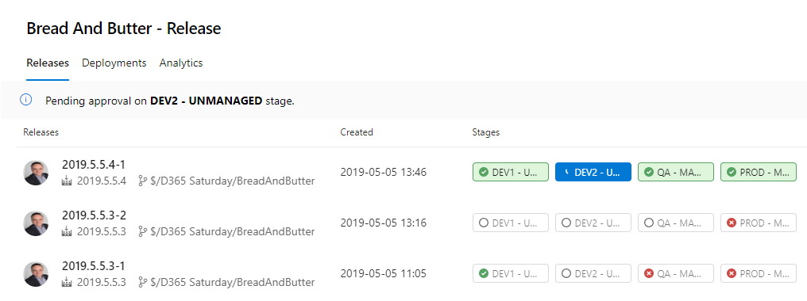
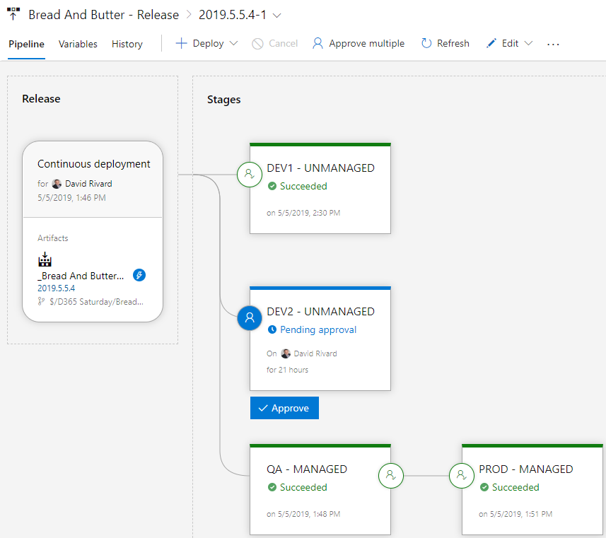
DEMO : Use Case – Starting From Scratch
STEP 3 : RELEASE to different environments
DEMO

Slide 29

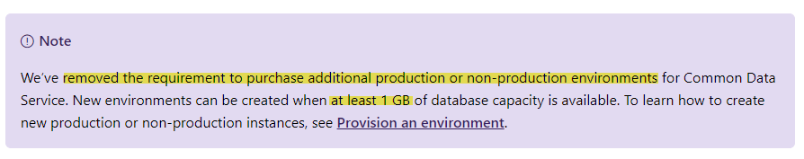
Limitations & Challenges
FLOWs that are transported with a solution will be imported as draft and connections will need to be manually re-configured on the target environment
Canvas apps importing errors
Ramp-Up of non-technical ressources to use Devops Tools (Visual Studio, Azure Devops)
Need a lot of environments to be efficient.
New licensing model should help

Slide 30
Questions?

Slide 31
THANK YOU TO THE COMMUNITY SPONSORS!

Slide 32
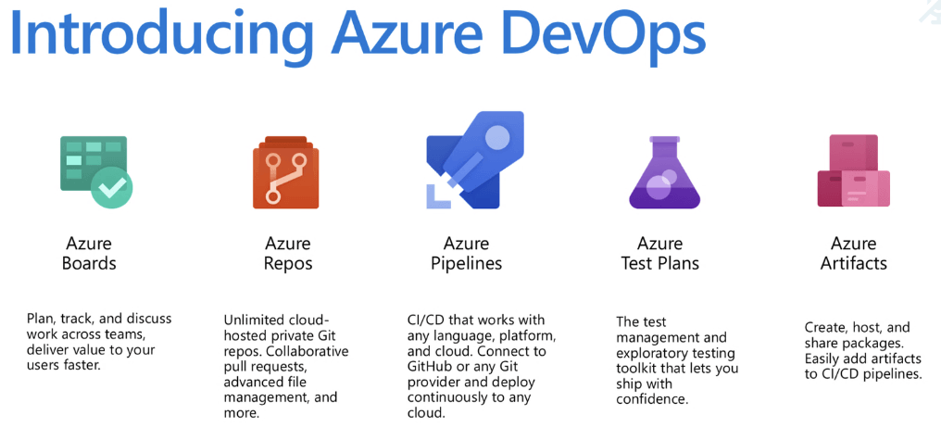
Tools : Azure DevOps
Integrated suite of tools that empowers every actor involved in application delivery
Azure Boards : Project Management
Azure Repos : Source Code
Azure Pipelines : Build/Release
Azure Test Plans : QA

